Slide 1


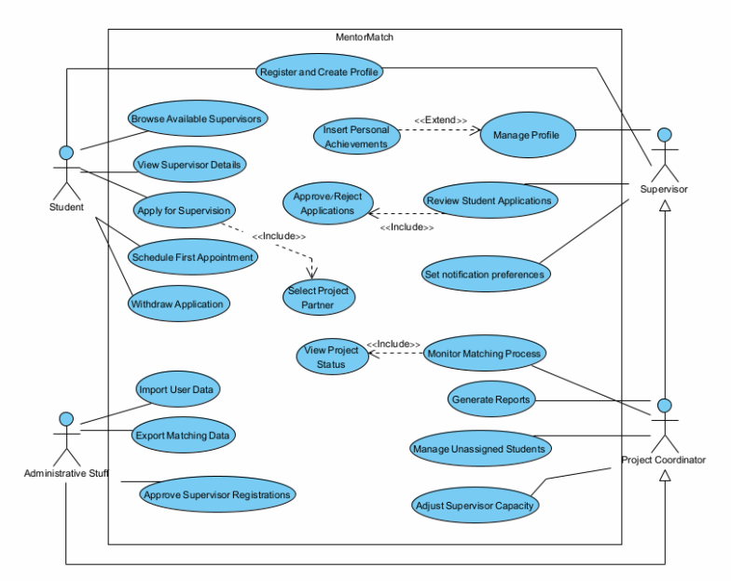
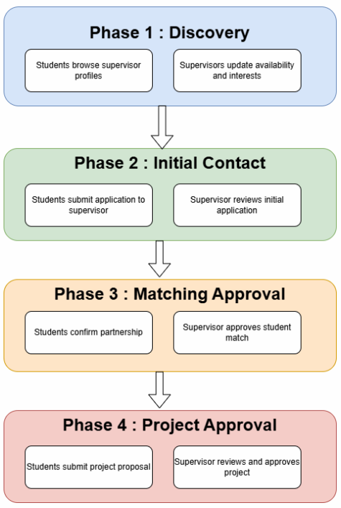
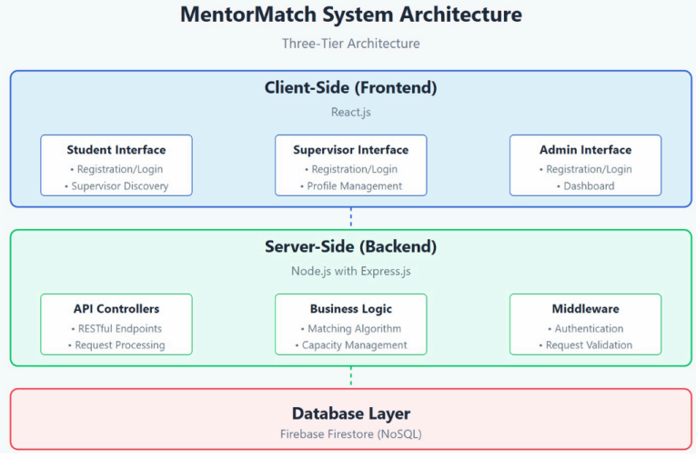
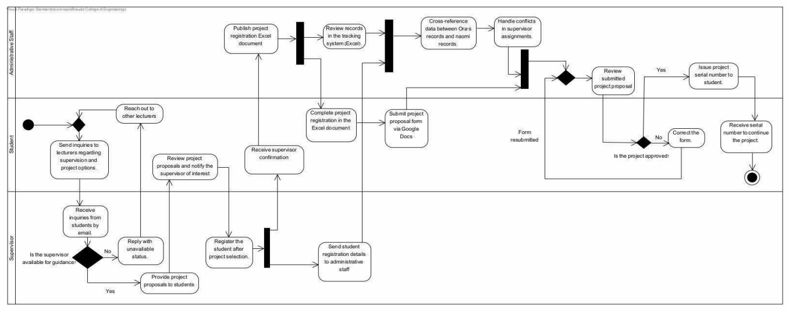
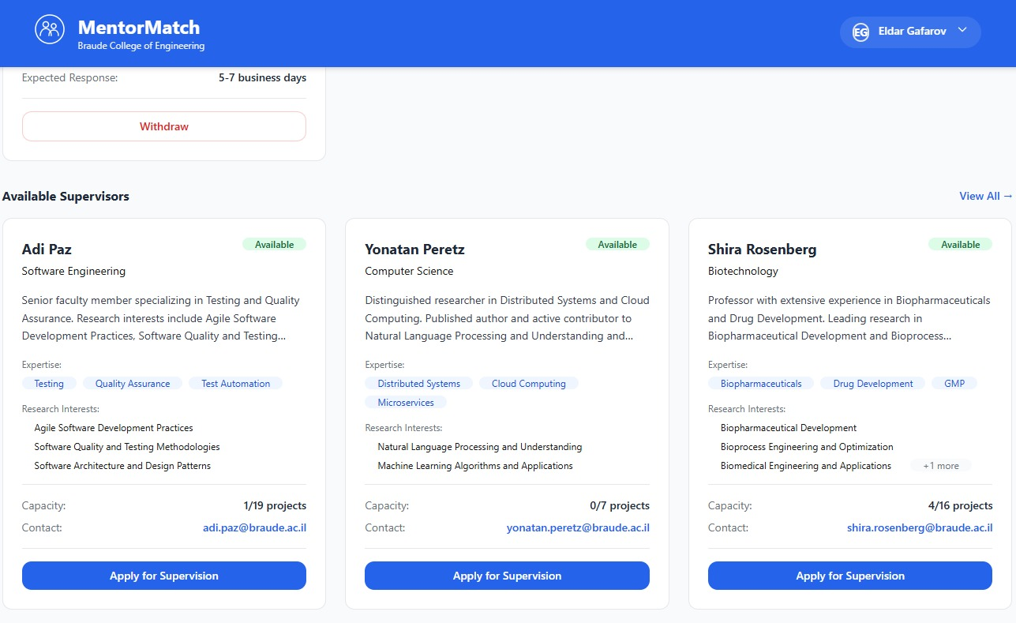
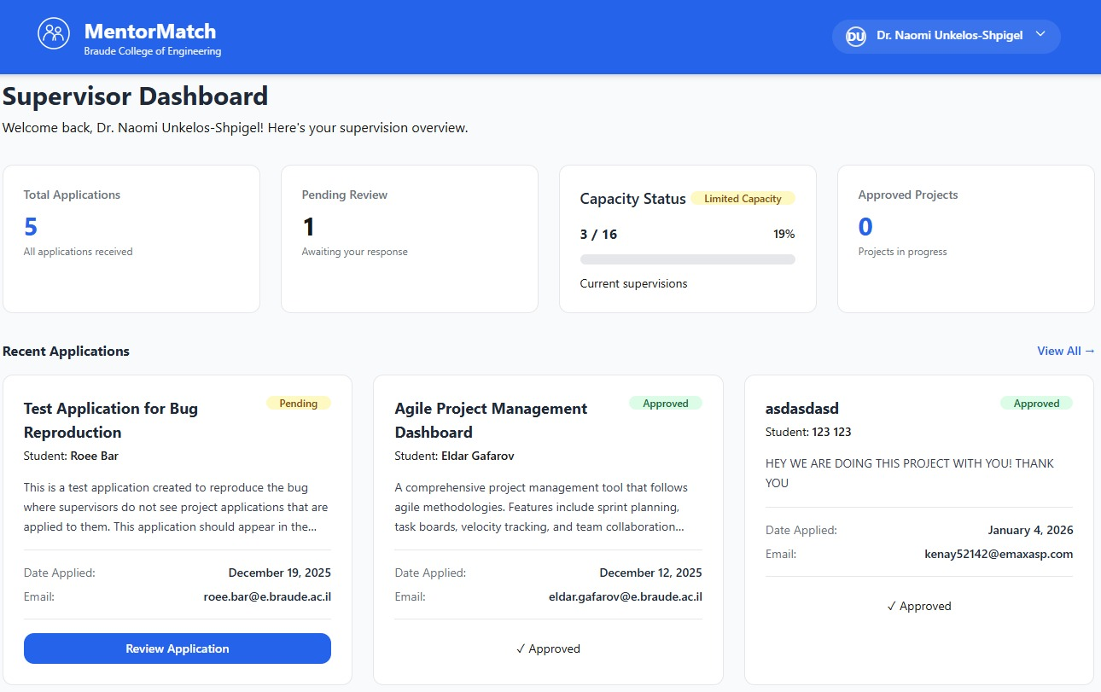
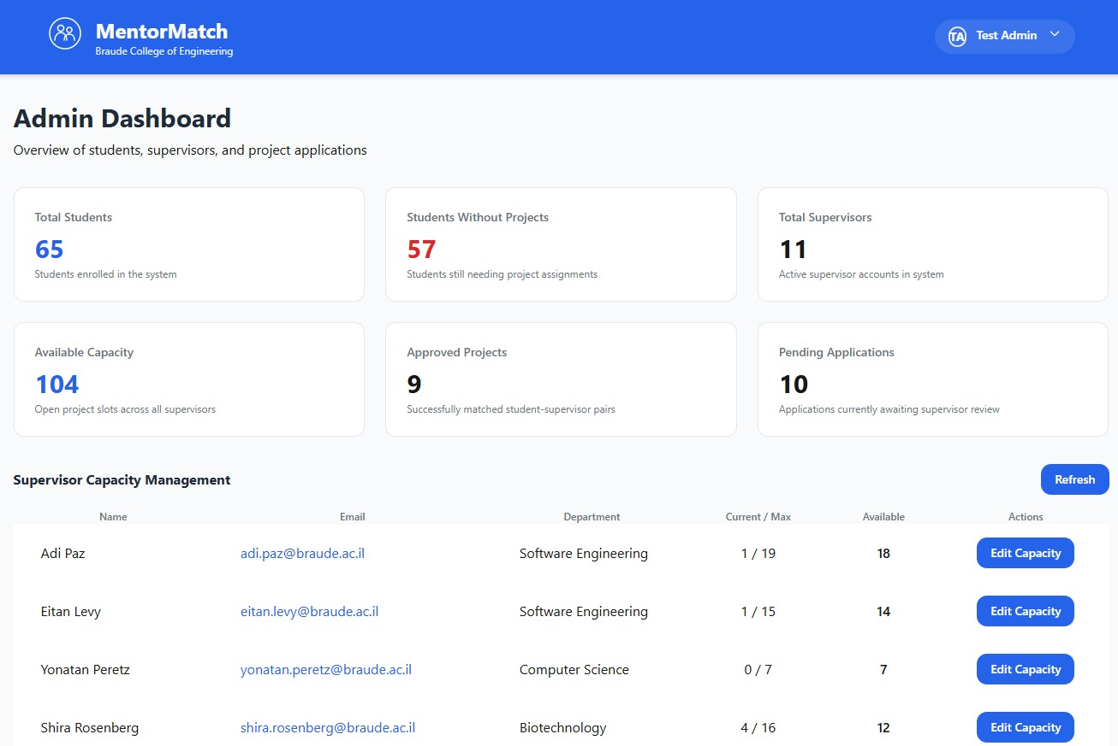
MentorMatch
Eldar Gafarov and Roee Bar
Supervisor: Dr. Julia Sheidin
Project Code: 25-2-D-7
Motivation
Supervisor’s Feedback
Student’s Feedback
At Braude College, students face significant challenges finding project supervisors. The current process relies on fragmented communication channels including emails, and word-of-mouth.
Our goal is to create a centralized, transparent platform that connects students with supervisors efficiently.
• "This will finally reduce the email spam, no more duplicate inquiries from students who already found someone else."
• "Students can see my availability upfront, so they know what to expect before reaching out."
• "The system handles the logistical overhead so I can focus on the actual mentoring."
• "Finally I can see which supervisors are available and what topics interest them."
• "Seeing supervisor capacity in real-time means I can stop wasting time on supervisors who are already full."
Use Case
Process Workflow
The Solution
We developed a comprehensive web platform, featuring supervisor profiles, student application portal, real-time matching dashboard, and administrative oversight tools. The platform uses modern web technologies for a clean, user-friendly interface with secure authentication.
Key Features
• Supervisor profiles with research interests
• Structured student application system
• Real-time capacity tracking
• Automated email notifications
• Administrative oversight dashboard
Impact & Benefits
• Elimination of double-booking conflicts
• Reduce of email overhead
• Real-time availability tracking and project statuses
• Formal commitment mechanism
Challenges & Constraints
• User Adoption: Resistance from email-based processes
• Data Management: Accurate capacity tracking
• Integration: ProjectHub compatibility
• Communication: Structured stakeholder messaging
Application Screenshots

